Slide 1
Demonstration of Website and Reporting Portal of UBA
Prof. Ram Chandra
National Coordinating Institute – IIT Delhi

Slide 2
Purpose of website
Spreading our Vision & Mission to Increase Participation
Creating Awareness Among General Public
Easy Communication Between Stakeholders of the Abhiyan

Slide 3
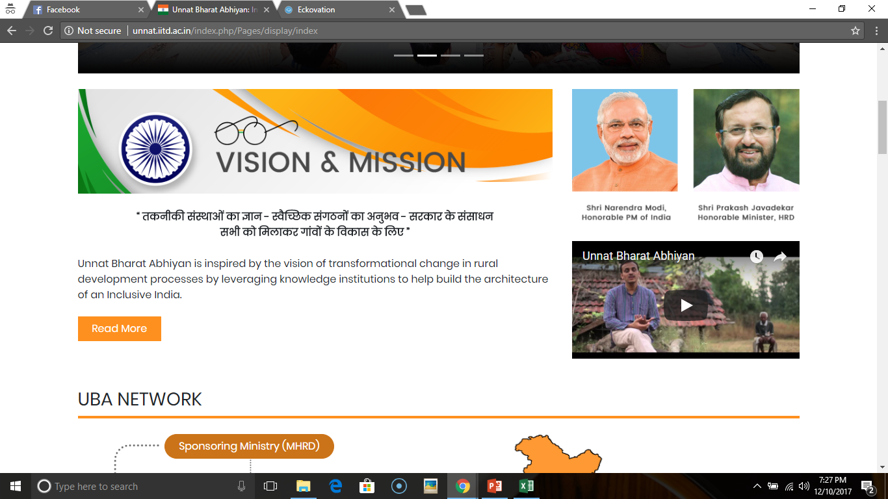
Features of Website
Interactive Map for Public Viewers
Field Experiences
Applications, Ranking, Selection List and Registration for Orientation: Join UBA
Monitoring of Participating Institutes: Reporting Portal

Slide 4
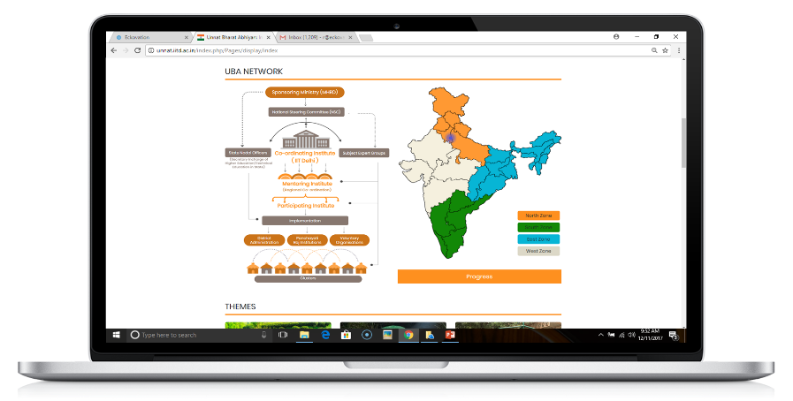
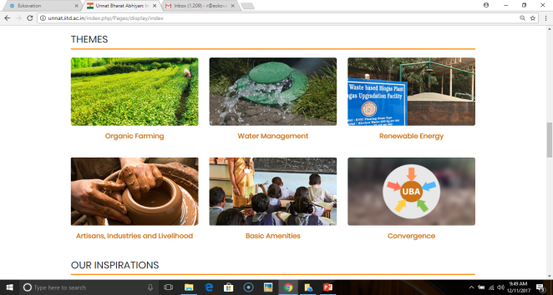
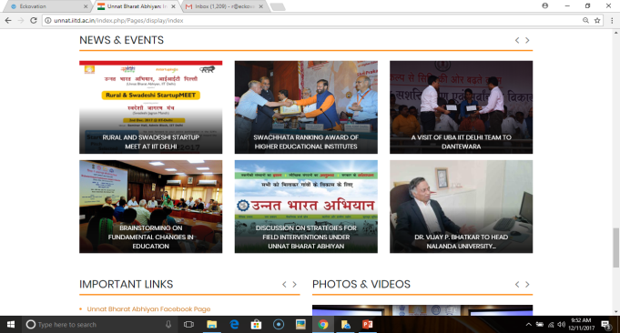
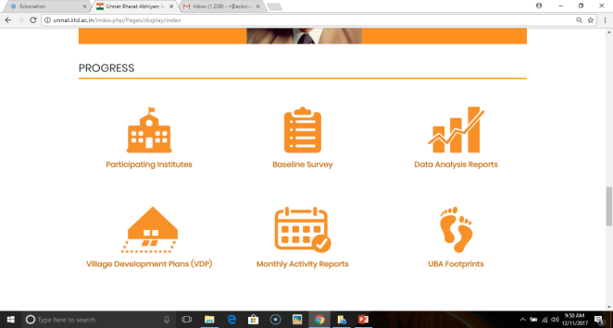
Other Important Sections
UBA Network
Themes
News & Events
Progress

Slide 5
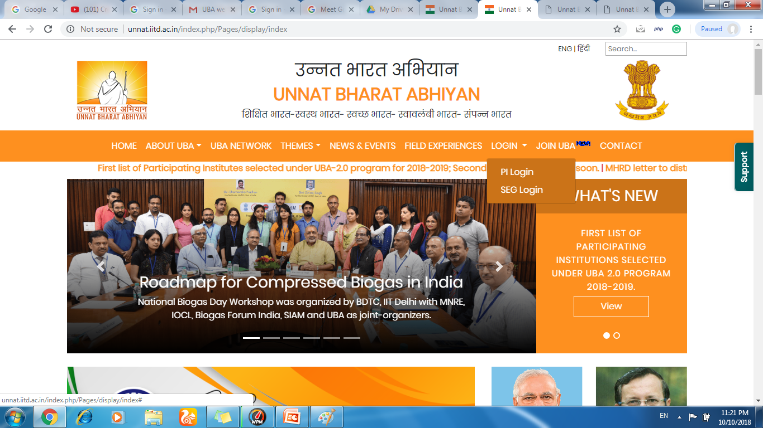
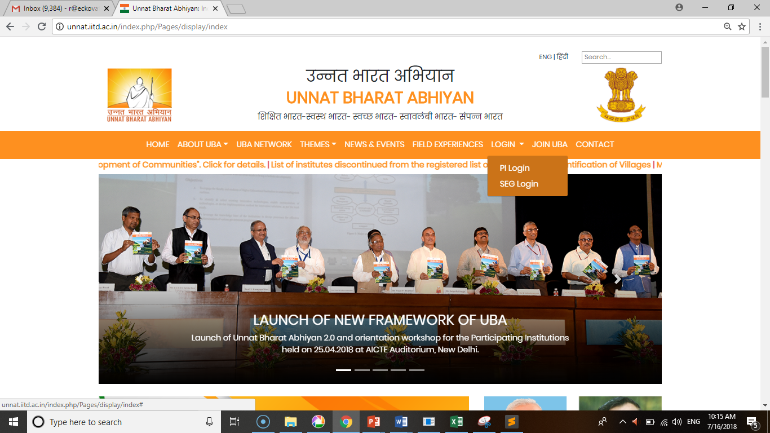
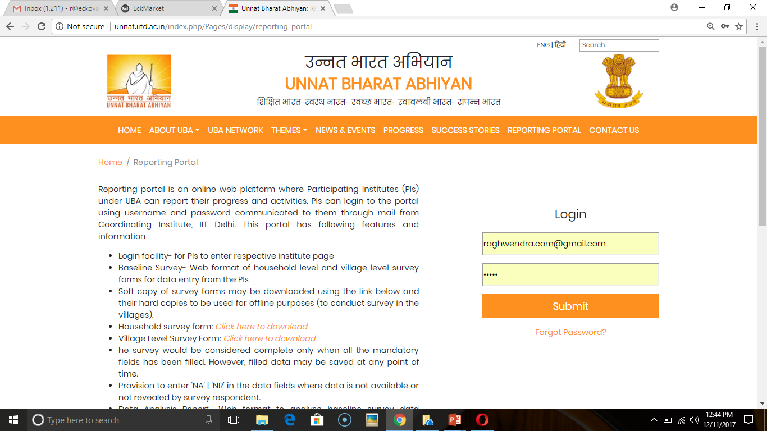
UBA Website

Slide 6
Reporting Portal
Village/Household Level Survey
Data Analysis Report
Monthly Activity Reports of PIs
SEG Portal

Slide 7
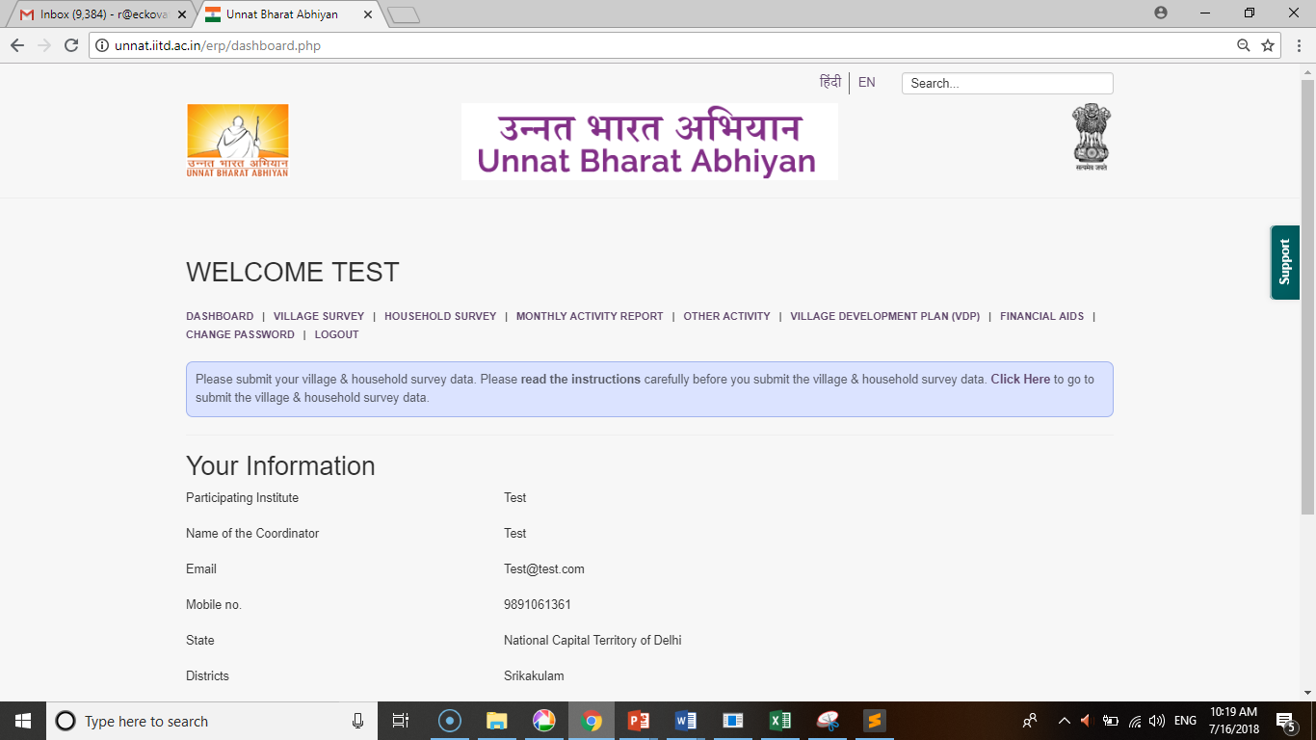
Reporting Portal

Slide 8
Strong Support System
Quick Support
Button

Slide 9
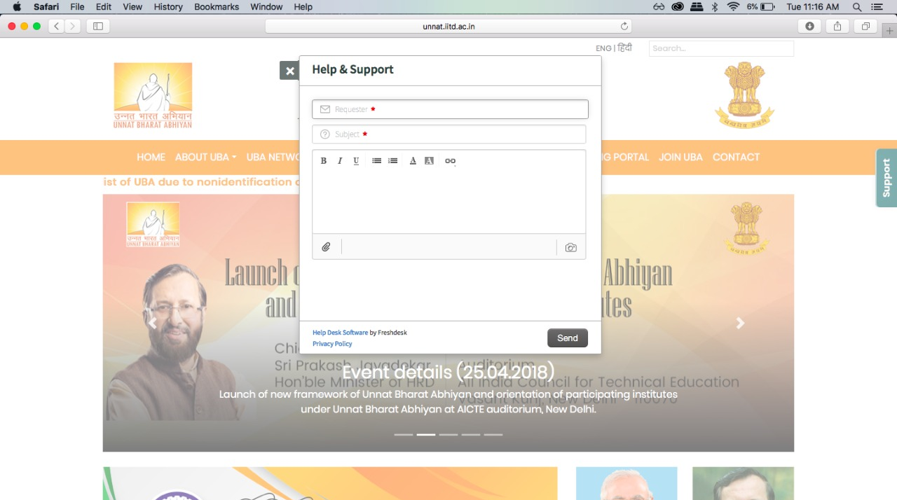
Strong Support System
No need to send email, just write the query and get quick response from the UBA team

Slide 10
SEG Portal for PI

Slide 11
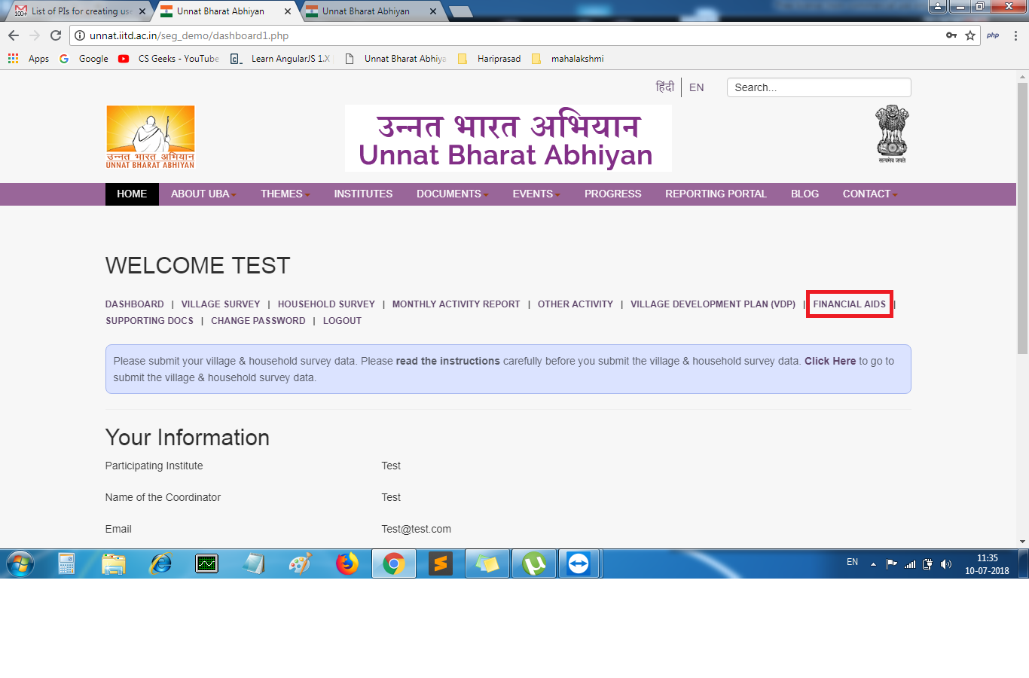

Slide 12
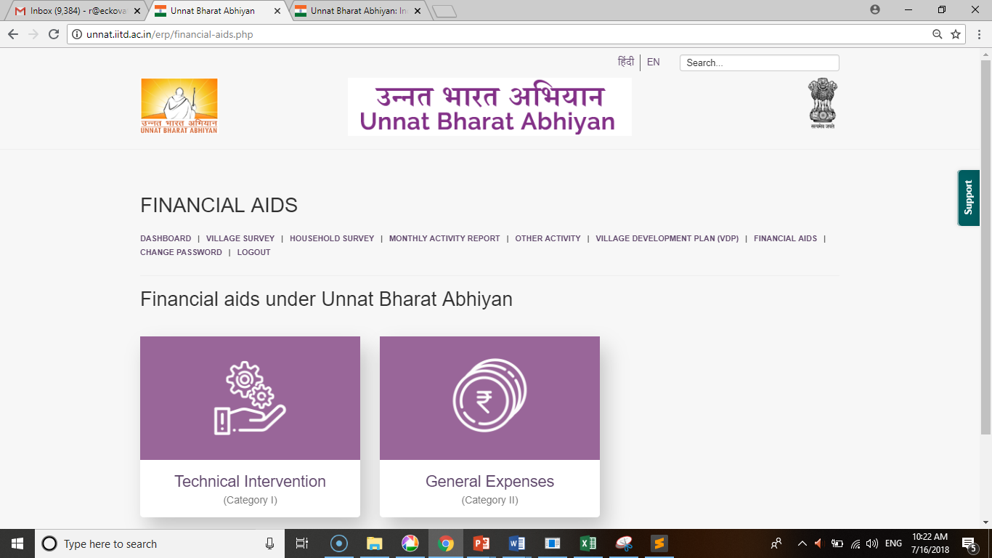

Slide 13
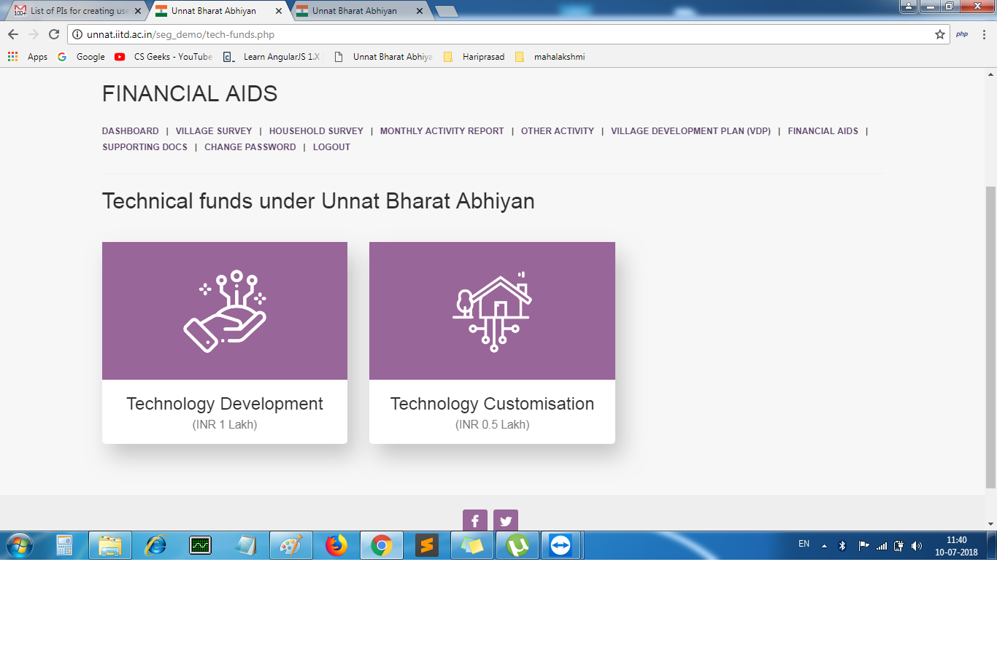

Slide 14
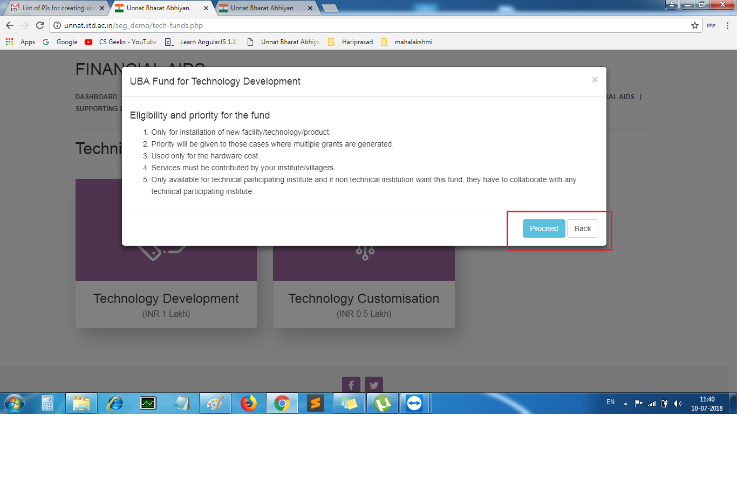

Slide 15
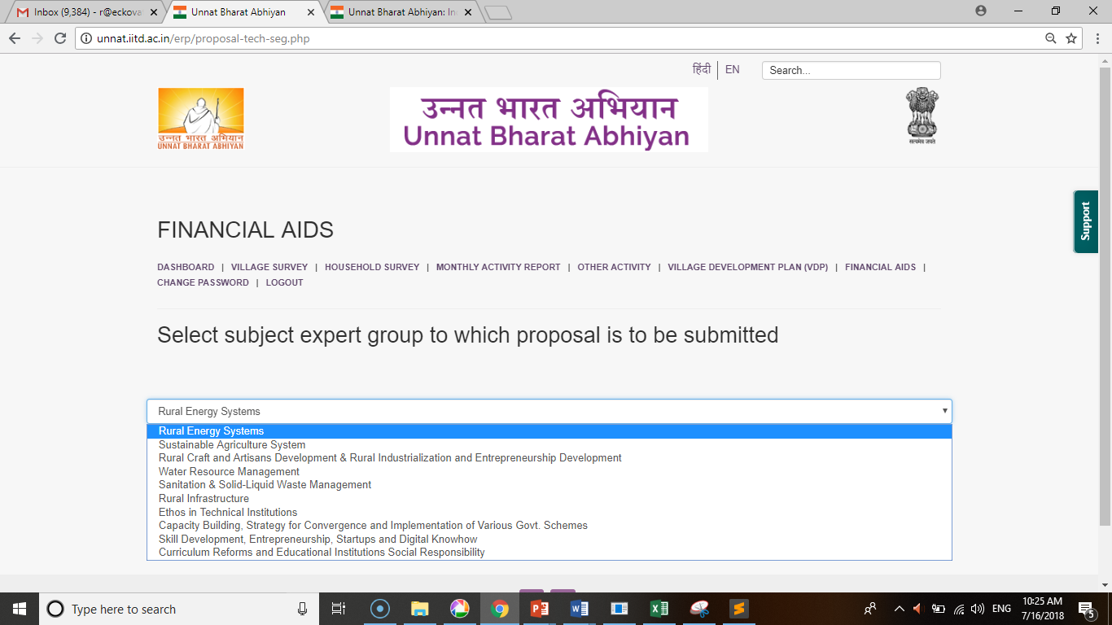

Slide 16
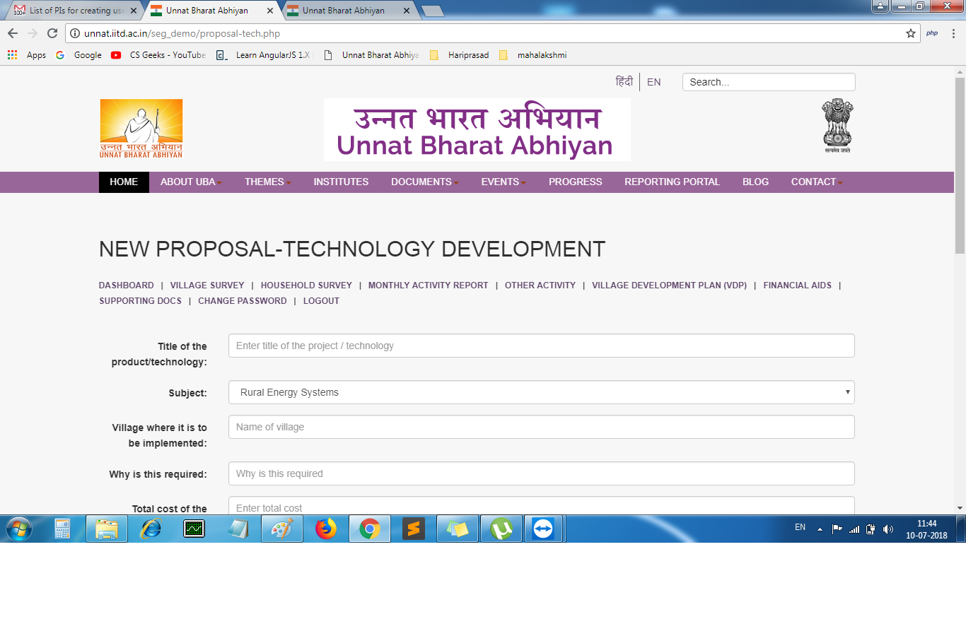

Slide 17
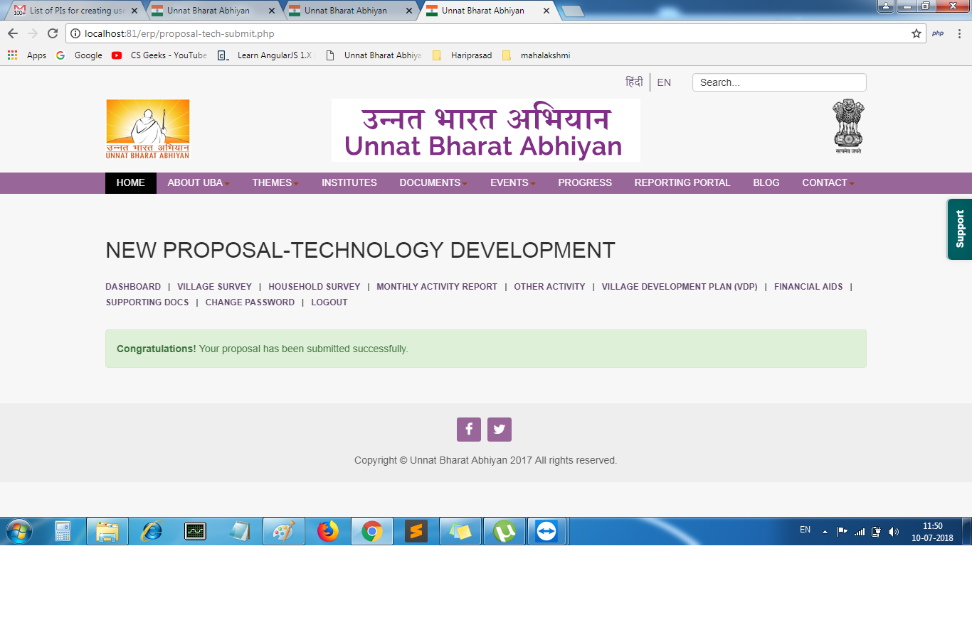

Slide 18
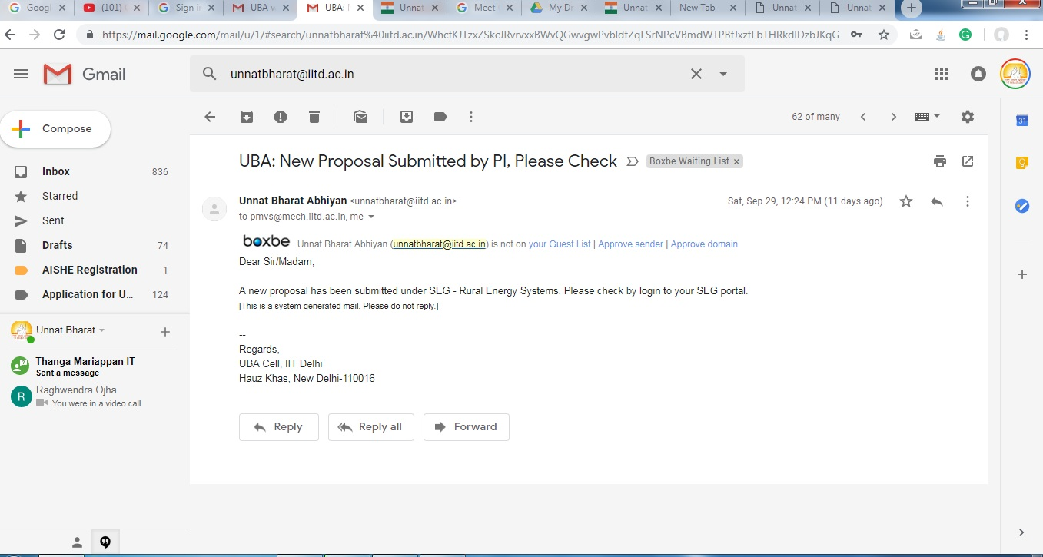
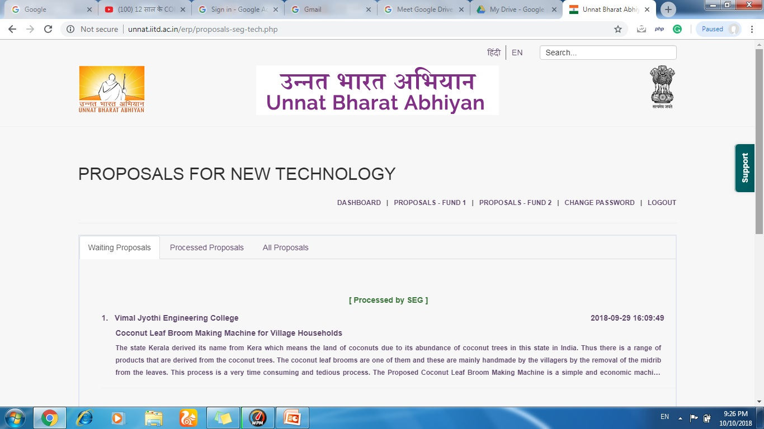
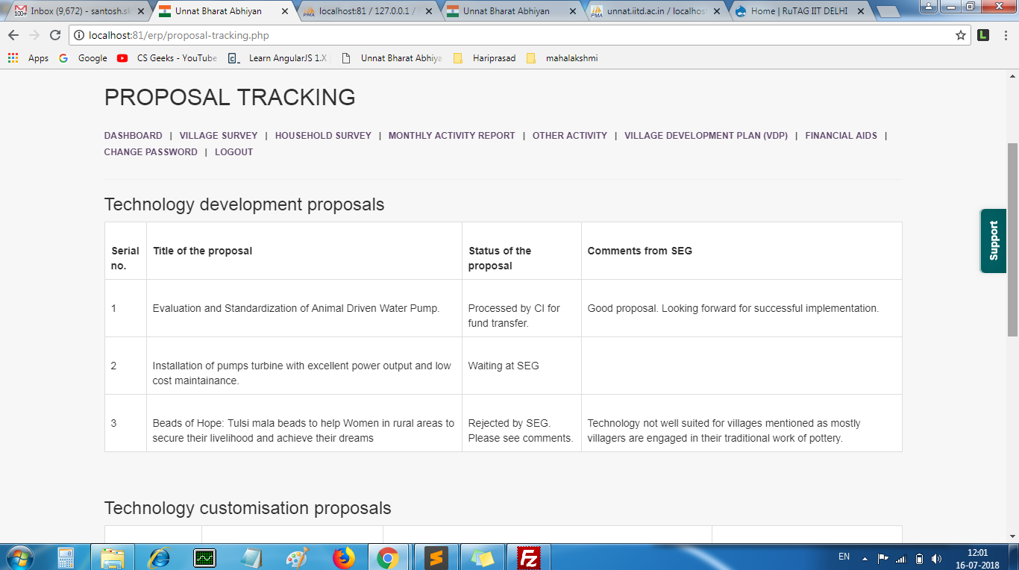

Slide 20
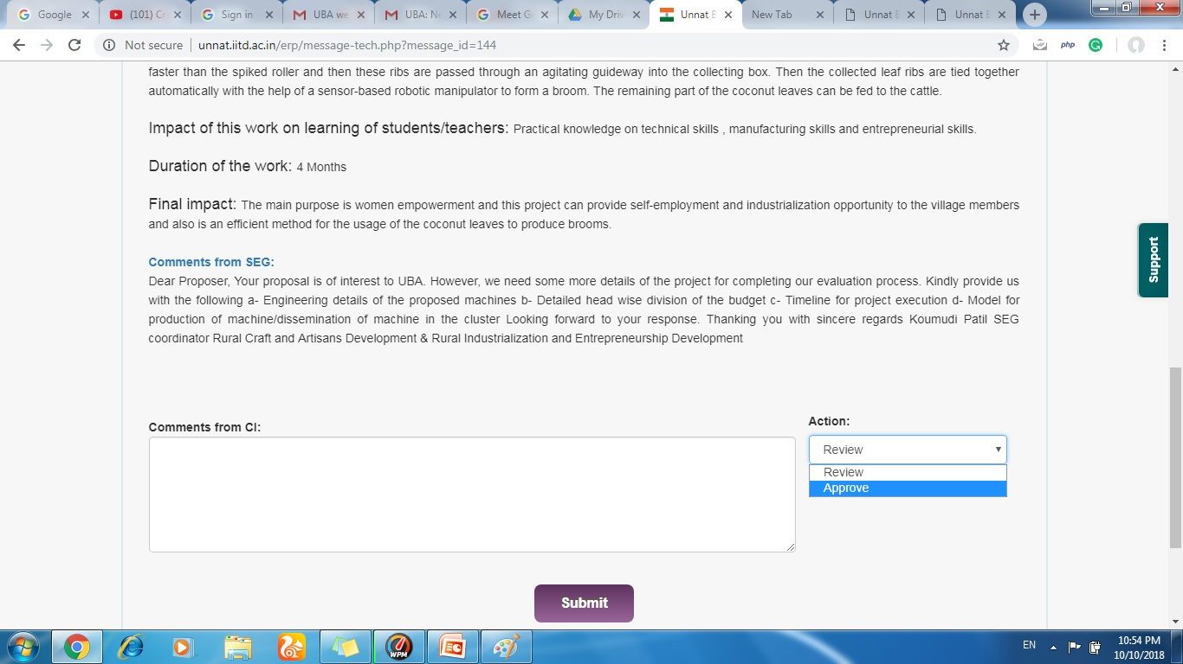

Slide 21
Plan of Action

Slide 22
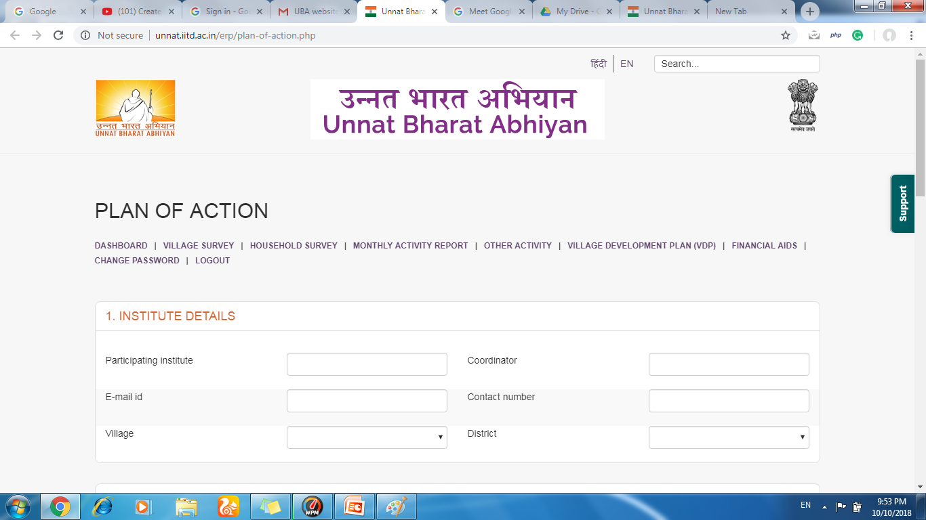
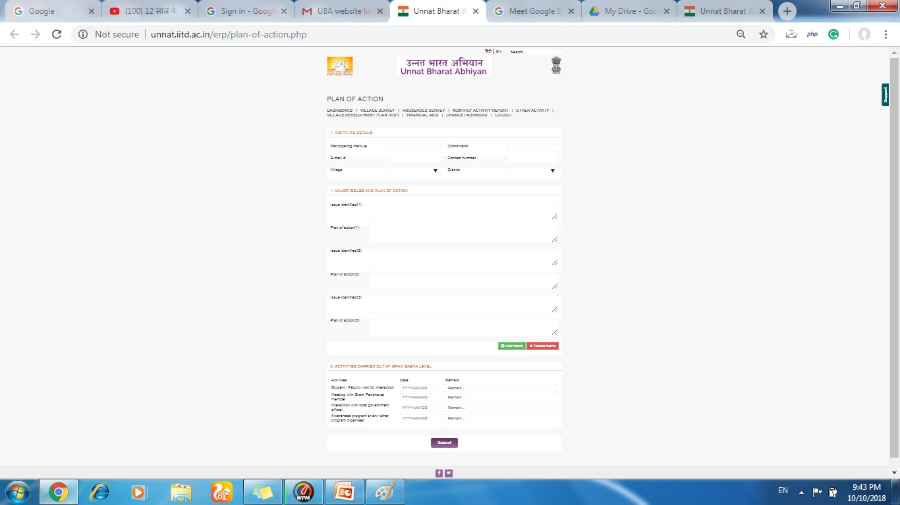

Slide 23
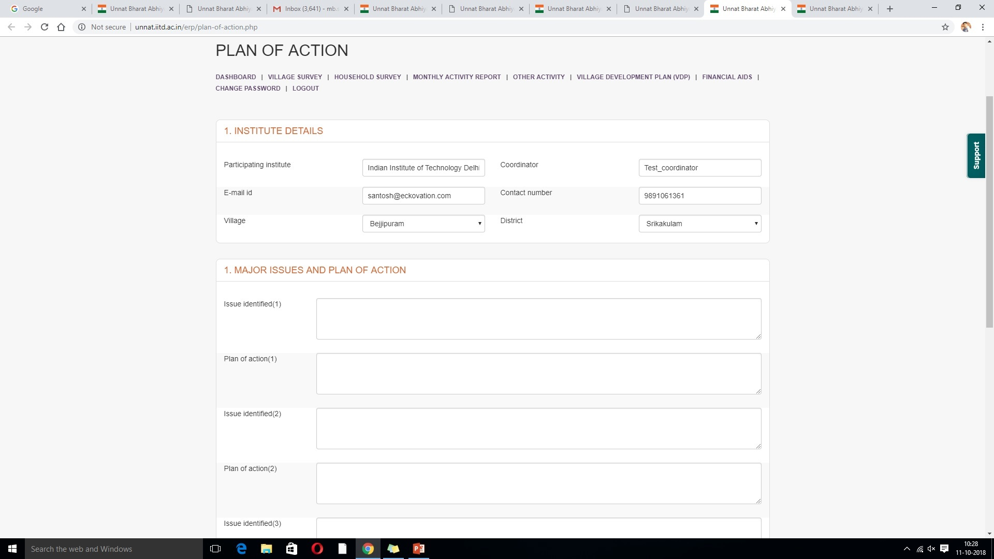

Slide 24
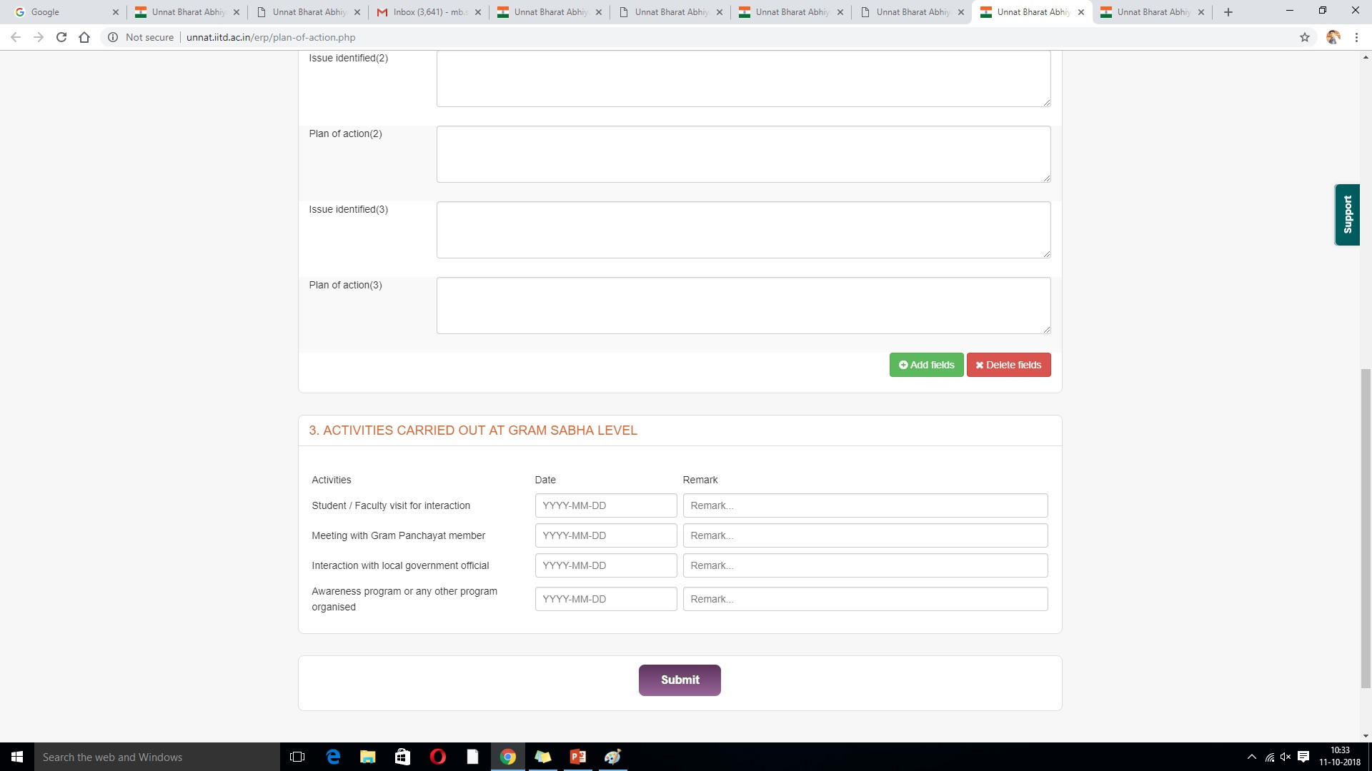

Slide 25
ERP- Admin Login

Slide 26
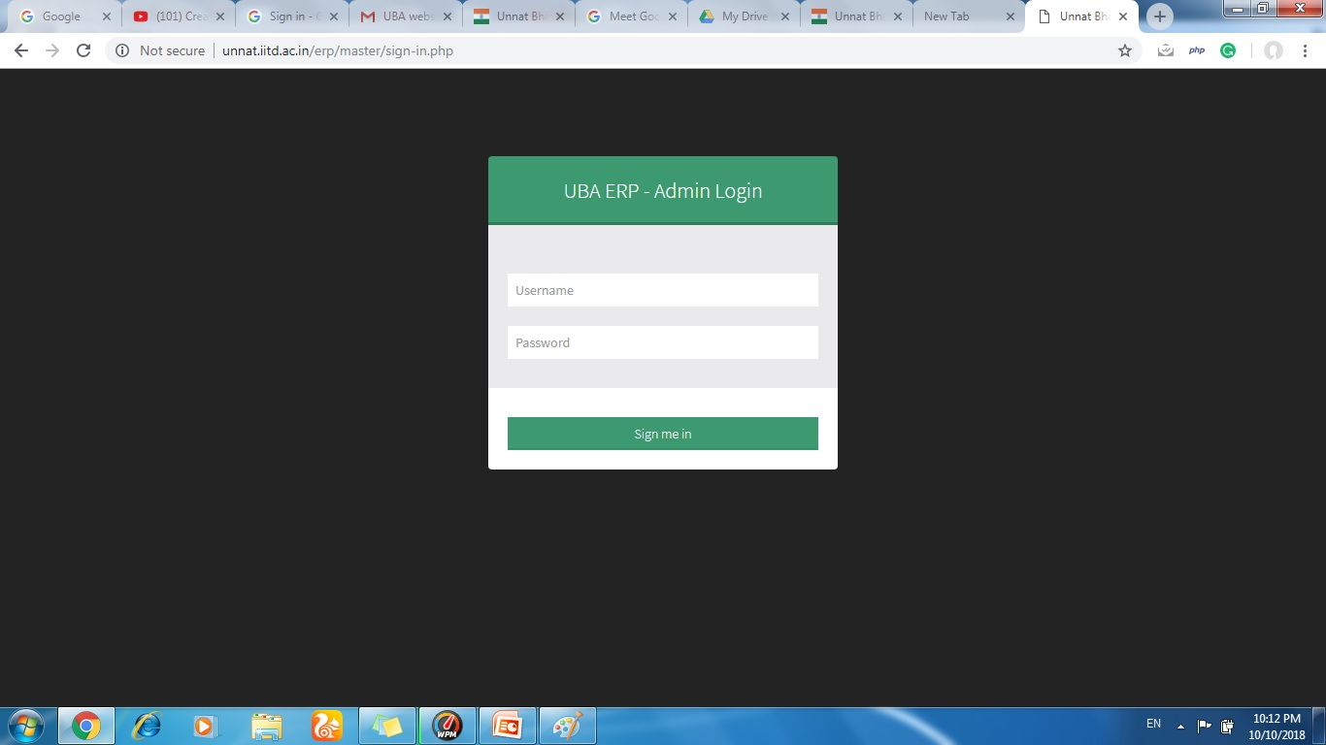

Slide 27
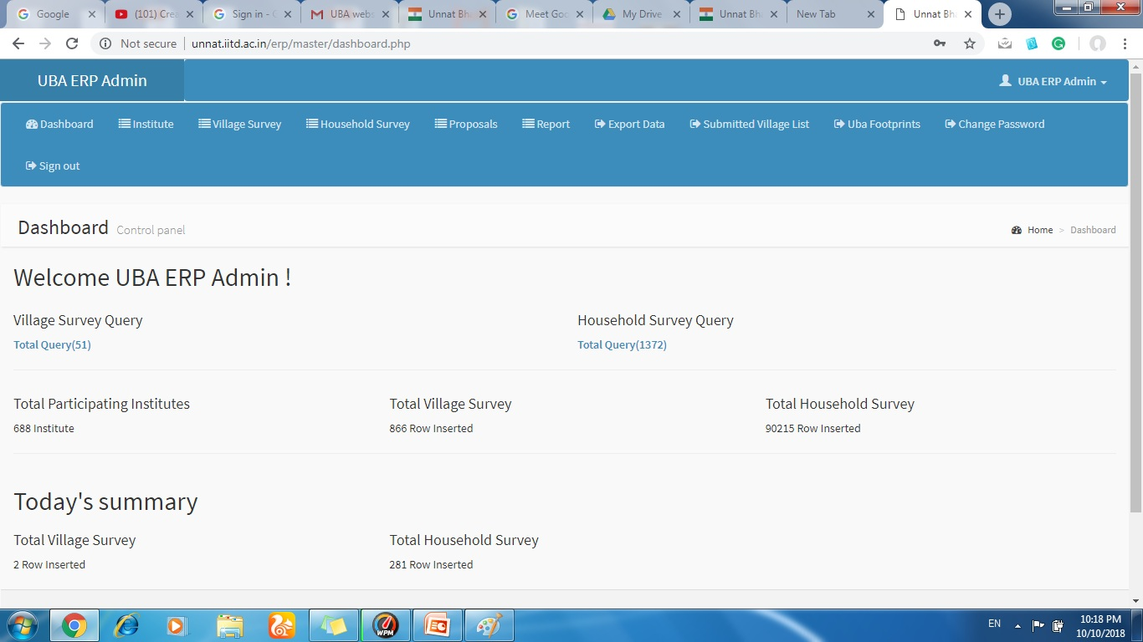

Slide 28
http://unnatbharatabhiyan.gov.in/

Slide 29
Thank You
Contact Us
Unnatbharatabhiyaniitd@gmail.com
011-26591121/1157

